Slide 1
Data Science Case Study
Azmina Vanzara

Slide 2
Outline
Source data and Source code
Abstract
Organization of Analysis
EDA Major Milestones
Imbalanced Target Column
Data Visualization
Model Building- classification
Matrix for Analysis
Model Considered for Evaluation

Slide 3
Source data and Source Code GitHub Repo
Source Data
From: UC Irvine’s Machine Learning Repository
Topic: Bank Marketing
https://archive.ics.uci.edu/ml/datasets/Bank+Marketing#
Source Code
GitHub Repo :https://github.com/azmeena1311/Bank-Marketing

Slide 4
Abstract
The data is related with direct marketing campaigns of a Portuguese banking institution. The marketing campaigns were based on phone calls. Often, more than one contact to the same client was required, in order to access if the product (bank term deposit) would be ('yes') or not ('no') subscribed.
The classification goal is to predict if the client will subscribe (yes/no) a term deposit (variable y).

Slide 5
Organization of analysis:
Exploratory data analysis (EDA)
Data Pre-processing
Model Building
Use All Model To Predict
Model Evaluation

Slide 6

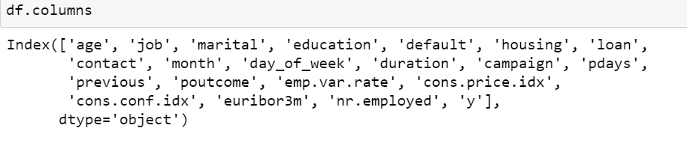
EDA - Insights about Data
We have 21 Columns and 41188 rows
The columns are :
No missing Values are present.
Out of the total features available :
11 are objects.
5 are int64
5 are float64

Slide 7
EDA Major Milestones
Handle Missing value
Removing duplicates
Outlier Treatment
Normalizing and Scaling( Numerical Variables)
Encoding Categorical variables( Dummy Variables)
Bivariate Analysis

Slide 8
Encoding Categorical variables
Label Encoding : In label encoding in Python, we replace the categorical value with a numeric value between 0 and the number of classes minus 1. If the categorical variable value contains 5 distinct classes, we use (0, 1, 2, 3, and 4).
Replace with Numerical Values Ordinal/Nominal : In this we used to encode categorical features into an ordinal numerical value (ordered set). This approach transforms categorical value to numerical value in ordered sets.

Slide 9
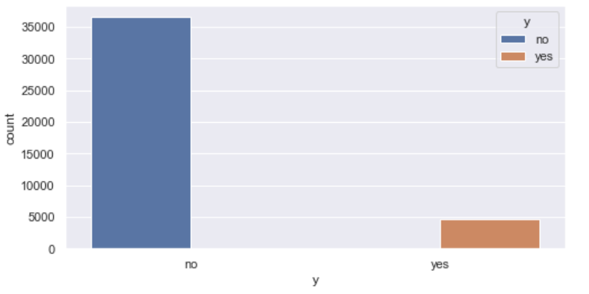
Problem: Target Variable is highly imbalanced.
11% has affirmative outcome while 89% has negative outcome.
Solution : Used SMOTE to do oversampling

Slide 10

Data Visualization
Univariate Analysis
Countplot
Bivariate Analysis
Countplot
Multivariate Analysis
Pairplot
Boxplot
Heatmap

Slide 11
Model Building - Classification
Logistic Regression
RandomForest Classifier
Xgboost Classifier
LGBM Classifier

Slide 12
Matrix used
Confusion Matrix
Precision
Recall
F1- Score
Roc_Auc score

Slide 13
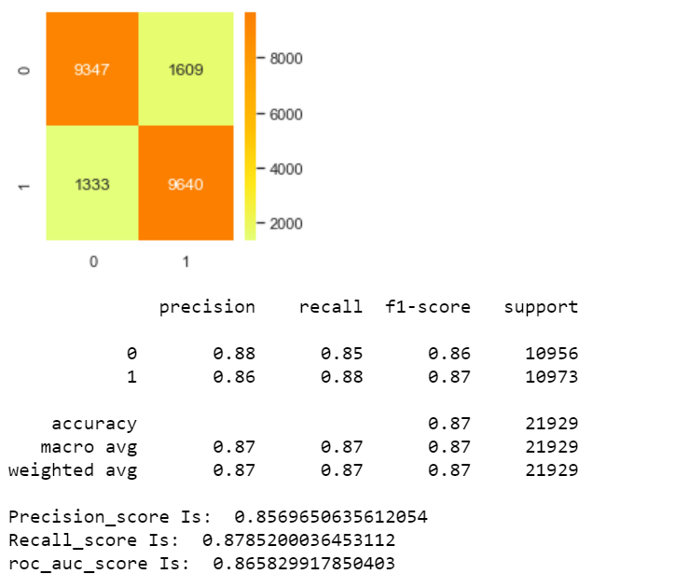
Logistic Regression

Slide 14
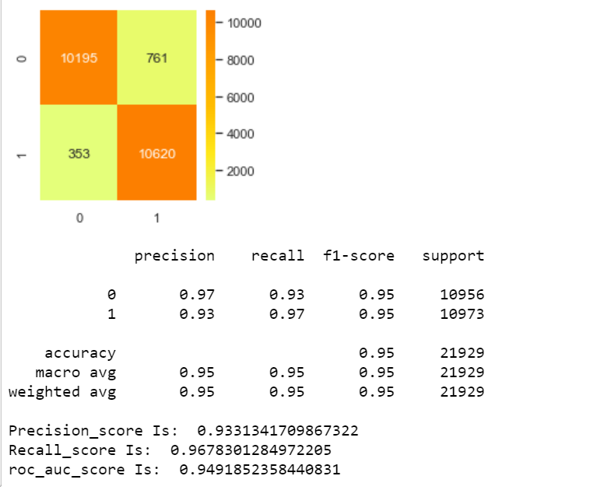
Random Forest Classifier

Slide 15
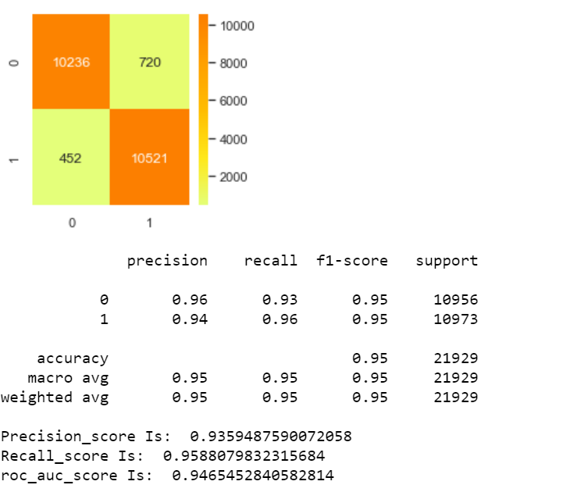
XGBClassifier

Slide 16
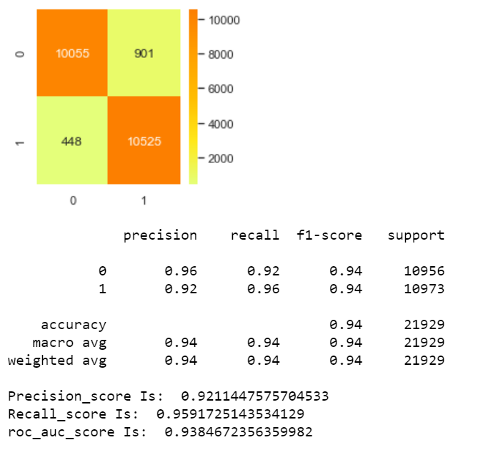
LGBMClassifier

Slide 17
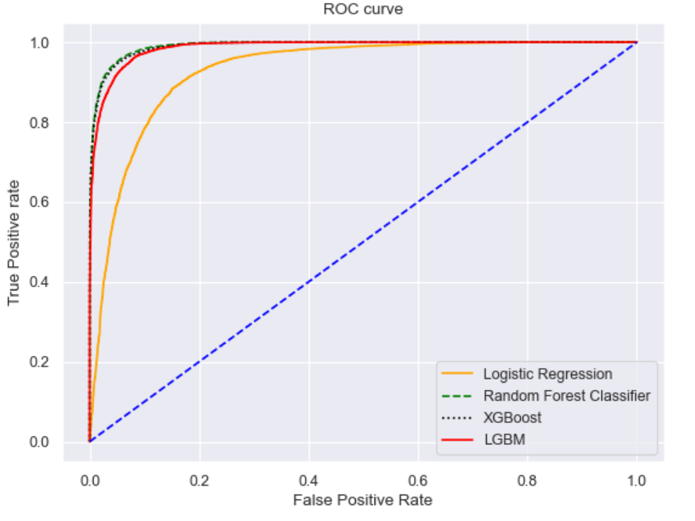
Use all Model to predict
ROC- AUC curve

Slide 18
Model Considered for Evaluation
Random Forest Classifier
XGBoost

Slide 19
Thank You

